Slide 1

10-minute delivery operations& performance optimization
Data-Driven Insights for Faster,Safer & Efficent Deliveries
Prepared by: Ambar Mandavkar
Power BI | Excel

Slide 2




Ceo of company
Albinder
Dhindsa
Amitesh
Jha
Kalyan Krishnamurthy
Aadit
Palicha
BLINKIT
SWIGGY INSTAMART
FLIPKART MINUTES
ZEPTO

Slide 3
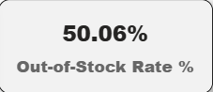
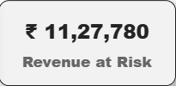
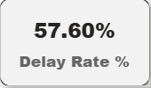
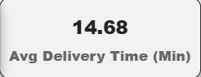
Opportunities / Chances
Problems
Smart warehouse pre-packing system
Real-time route optimization
Agent performance tracking & incentives
Inventory forecasting with analytics
Reduced accidents & faster fulfillment
High delivery pressure → safety risks
Increasing delay rate
Inventory stock mismatch
Poor agent efficiency in peak hours
Revenue loss from failed orders

Slide 4

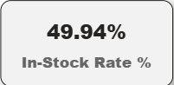
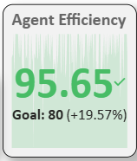
Objectives
Reduce average delivery time
Lower delay rate & failed orders
Improve agent efficiency & safety
Optimize inventory availability
Increase overall revenue performance

Slide 5
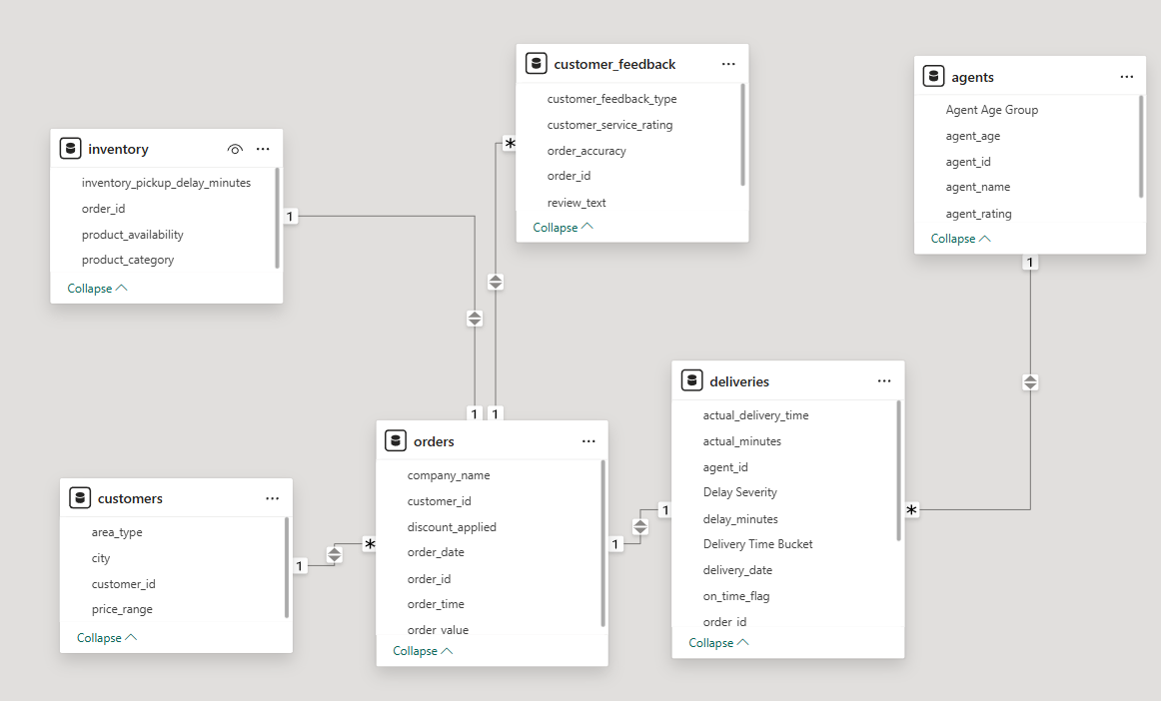
Data Model &Table Relationships
Central fact table: Orders capturing all transactions
Delivery table linked for (time performance & delays)
Agent table linked for (workforce efficiency analysis)
Inventory table for (stock impact on delivery speed)
Customer & feedback tables for (experience insights)
Star schema structure for (optimized analytics performance)
“This relational data model ensures accurate performance tracking across delivery, inventory, agents, and customer experience.”

Slide 6

Data Cleaning&preprocessing
Delivery Delay (Actual − Expected time)
Delay Severity Buckets (On-time, Minor, Moderate, High)
Agent Age Groups (18–22, 23–27, 28–32…)
Inventory Status (In-Stock / Out-of-Stock)
Performance KPIs (Efficiency %, Delay Rate)
Removed duplicate orders & invalid delivery records
Handled missing delivery time & agent rating values
Standardized time formats (minutes & timestamps)
Filtered out cancelled & test orders
Corrected inconsistent company names

Slide 7
DAX Calculations & Key Business Metrics
Average Delivery Time
Avg Delivery Time = AVERAGE(deliveries[actual_delivery_time])
Delay Rate %
Delay Rate % = DIVIDE(COUNT(delayed orders), total orders)
SLA Compliance %
SLA % = DIVIDE(on-time deliveries, total deliveries)
Stock Availability %
In-Stock % = DIVIDE(in-stock orders, total orders)
Business Impact :
Identified high delay risk zones
Measured real agent performance
Tracked inventory-driven order loss
Created live operational KPIs

Slide 8
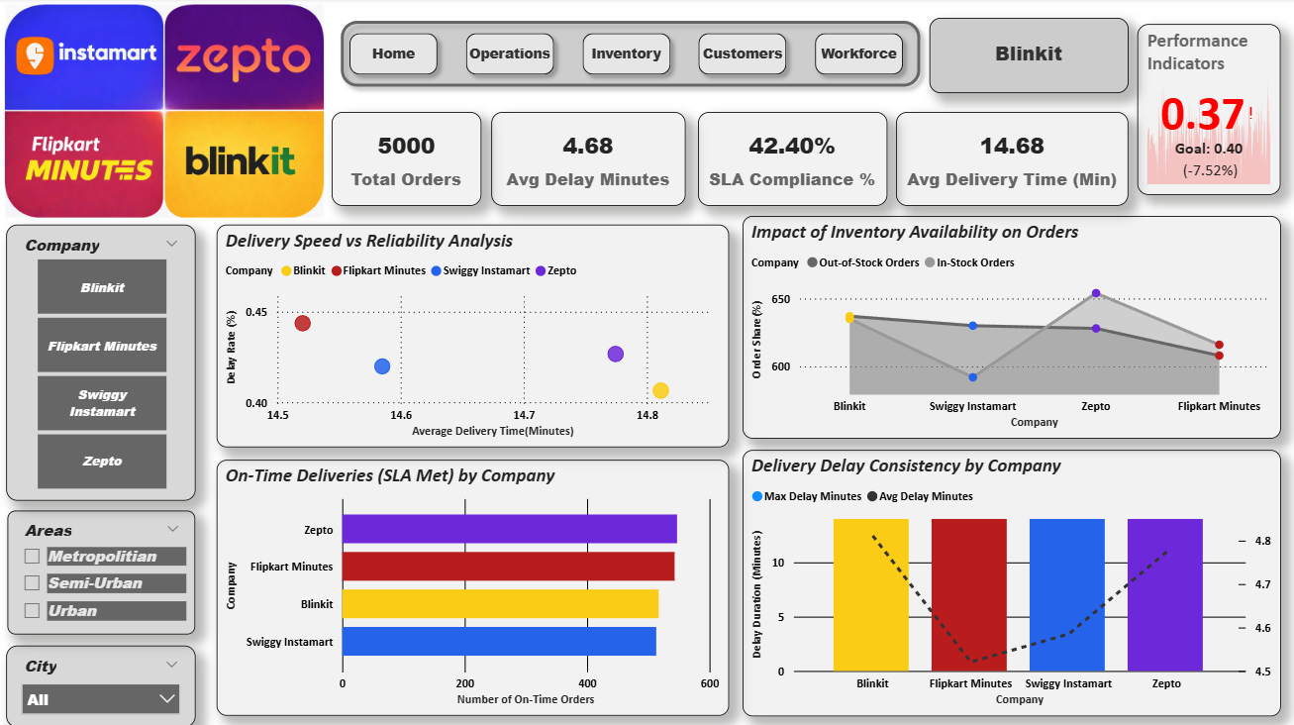
Dashboard
Key Insights :
• Average delivery time is fast (~14–15 minutes) but delay rate remains high, showing speed without reliability
• Faster deliveries are linked with higher delay risk — extreme speed targets reduce service stability
• In-stock orders are delivered quicker and more consistently than out-of-stock orders
• Poor inventory availability directly increases delays and failed deliveries
• SLA compliance varies by company, proving backend efficiency matters more than rider speed
• Repeated high delays indicate system issues like poor routing, late picking, and workload imbalance

Slide 9
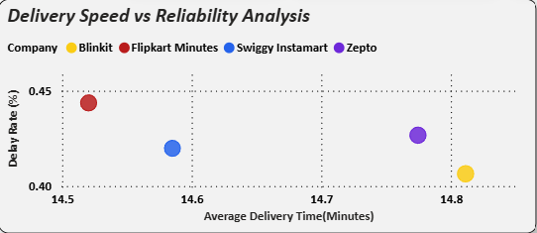
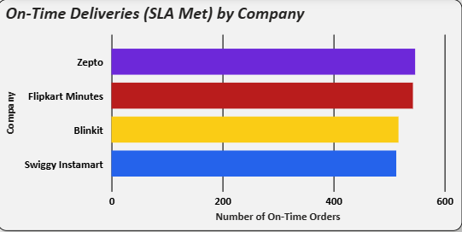
Operational Efficiency & Customer Satisfaction Overview
Insights :
Faster deliveries consistently result in lower delay rates
Companies with higher average delivery time experience more service
Business Value:
Direct impact on customer satisfaction
Lower delays reduce complaints and churn
Improves brand trust and repeat orders
Insight:
Higher SLA compliance directly correlates with better ratings
Late deliveries are the primary driver of negative feedback
Business Value:
Improves operational reliability
Controls customer experience quality

Slide 10
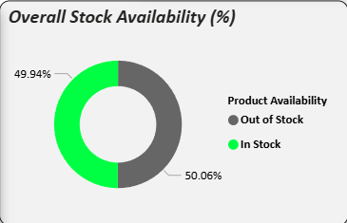
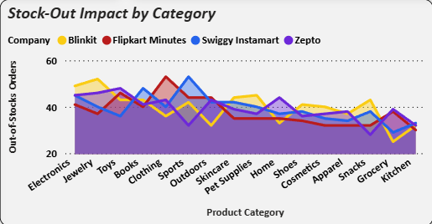
Inventory Efficiency & Revenue Risk Analysis
Insights :
Nearly half of customer demand is impacted by stock unavailability
High out-of-stock rates are limiting order fulfillment
Business Value:
Direct revenue loss
Increased customer dissatisfaction
Lower repeat purchases
Insights :
Certain categories face consistently higher stock shortages
These categories contribute most to missed revenue opportunities
Business Value:
Helps prioritize inventory planning
Improves demand forecasting
Prevents sales leakage

Slide 11
FUTURE ENHANCEMENTS & BUSINESS ACTION PLAN
Inventory & Stock Management Improvements:
Implement daily stock audits for fast-moving categories
Introduce auto re-order system when stock drops below threshold
Priority restocking for high demand products
Pre-pack popular daily items in warehouses
Delivery Speed & Delay Reduction Strategy:
Real-time route optimization using traffic data
Peak-hour rider surge planning
Micro-warehouses closer to high demand areas
Pre-pick orders during rush hours
Agent Performance & Workforce Optimization:
Performance-based incentives for top riders
Training programs for low rated agents
Deactivate repeatedly poor performers
Bonus for on-time delivery streaks
Customer Experience & Retention Strategy:
Special offers for unhappy customers
City-specific service improvements
Loyalty rewards for daily customers
Priority delivery for high-value users
Smart Order & Demand Planning System:
Predictive system for daily recurring orders
Auto pre-pack frequent items
Free packing for loyal customers
Subscription-based daily essentials

Slide 12
SUMMARY
Quick-commerce platforms place heavy time pressure on delivery riders, often resulting in unsafe working conditions, delayed orders, product mismatches, and increased wastage. This project aims to demonstrate that faster delivery does not depend on rider stress, but on smarter inventory management and data-driven operational planning. The core motivation is to reduce extreme time pressure on riders while maintaining rapid delivery promises by improving inventory planning, order accuracy, and operational efficiency—making 10-minute deliveries safer, smarter, and more reliable.

Slide 13
THANK YOU
Ambar Mandavkar
ambarmandavkar07@gmail.com

